Slide 1
Python
Function
in programming

Slide 2








Slide 3













Slide 4
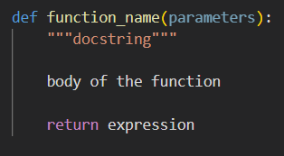
Python Functions
Functions
Syntax
A function is a block of code which only runs when it is called.
You can pass data, known as parameters, into a function.
A function can return data as a result.
def is use for define a function
Function Name
Functions Arguments/Parameter

Slide 5

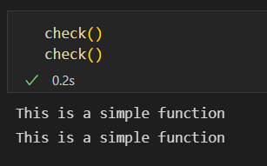
Defining and Calling Functions
Defining a Function
Calling a Function

Slide 6
Types of Python Function
Non-Parameterized Functions
Required Parameter
Default Parameter
Parametrized Functions
Keyword Parameter
Functions
Anonymous Parameterz
Variable Length Parameter
Return Value Functions
Lambda Expressions
Generator Functions
Decorators Functions

Slide 7
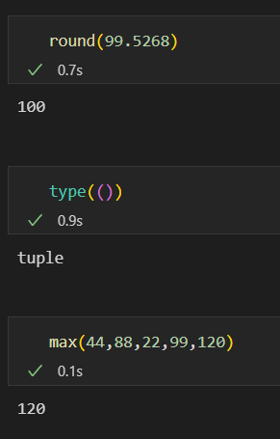
Python Functions
Build-In Functions
Examples
Built-In or Predefined functions are the functions that are already written or defined in python.
As these functions are already defined so we do not need to define these functions.

Slide 8
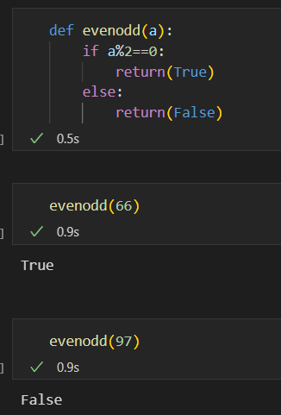
Python Functions
User Defined Functions
Example
User Defined functions are created and used by the user itself to do some specific task.

Slide 9
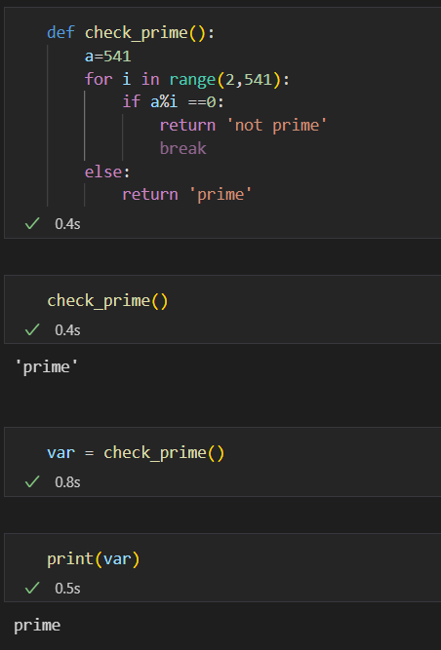
Python Functions
Example
Return Value Functions
Return value functions return something on function call.
The return value can be stored in a variable.
Value returned by function is stored in variable.

Slide 10
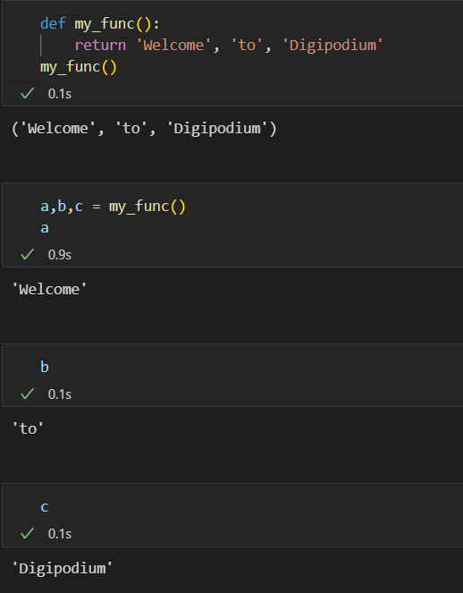
Python Functions
Multiple Return Value Functions
Example
Multiple values can also be returned in a functions.
The multiple return values are returned in the form of tuple.

Slide 11
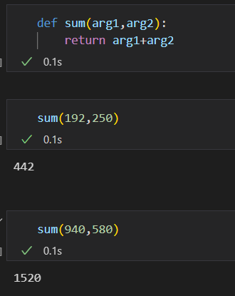
Python Functions
Parametrized Functions
Example
The Parametrized functions are those functions which requires passing of a no. of arguments.

Slide 12
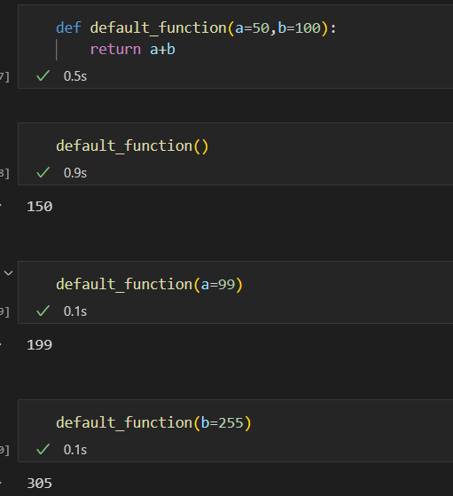
Python Functions
Default Parameter Functions
Example
The Default Parameterized functions have a default value set for their arguments.

Slide 13
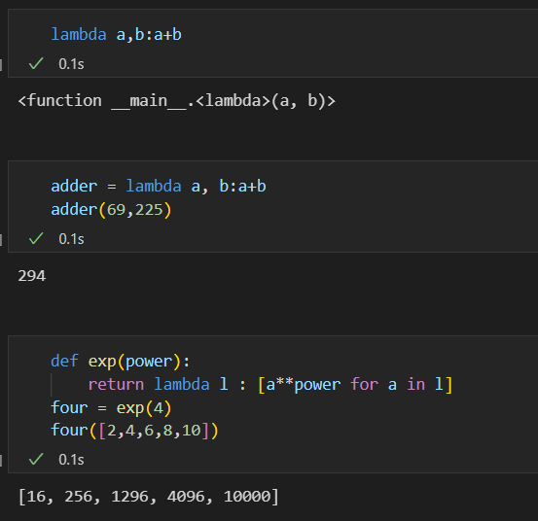
Python Functions
Anonymous Functions
Example
Anonymous functions are basically one line functions with do not require to be defined by any name.

Slide 14
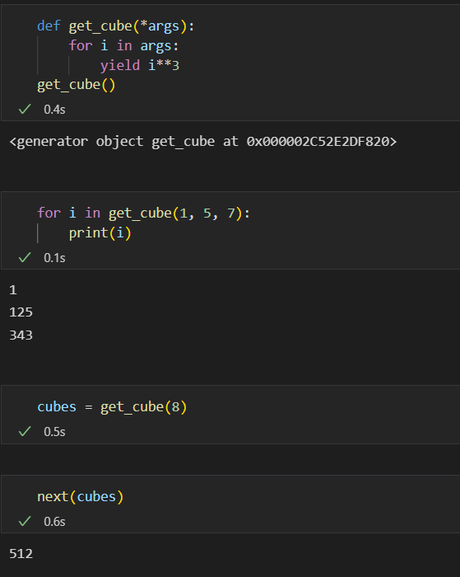
Python Functions
Example
Generator Functions
Python generators are a simple way of creating iterators.
A generator function returns an object (iterator) which we can iterate over (one value at a time) or can be converted to any data structure.

Slide 15
THE END

